Slide 1


School of Engineering Technology and Applied Science
API Engineering
Week 02
Reza Dibaj

Slide 2
Amazon Relation Database Service (RDS)

Slide 3
Amazon Relation Database Service (RDS)
Amazon RDS provides cost-efficient and scalable relational database capacity while automating time-consuming administration tasks such as hardware provisioning, database setup, patching and backups.

Slide 4
DB Instances
The basic building block of Amazon RDS is the DB instance.
A DB instance is an isolated database environment in the cloud. A DB instance can contain multiple user-created database, and you can access it by using the same tools and applications that you use with a stand-alone database instance.
Each DB instance runs a DB engine. Amazon RDS currently supports Amazon Aurora, MySQL, MariaDB, PostgreSQL, Oracle, and Microsoft SQL Server DB engines.

Slide 5
Amazon Aurora
Amazon Aurora is a MySQL- and PostgreSQL-compatible enterprise-class database, starting at <$1/day
Up to 5 times the throughput of MySQL and 3 times the throughput of PostgreSQL
Up to 64TiB of auto-scaling SSD storage
6-way replication across three Availability Zones
Up to 15 Read Replicas with sub-10ms replica lag
Automatic monitoring and failover in less than 30 seconds

Slide 6
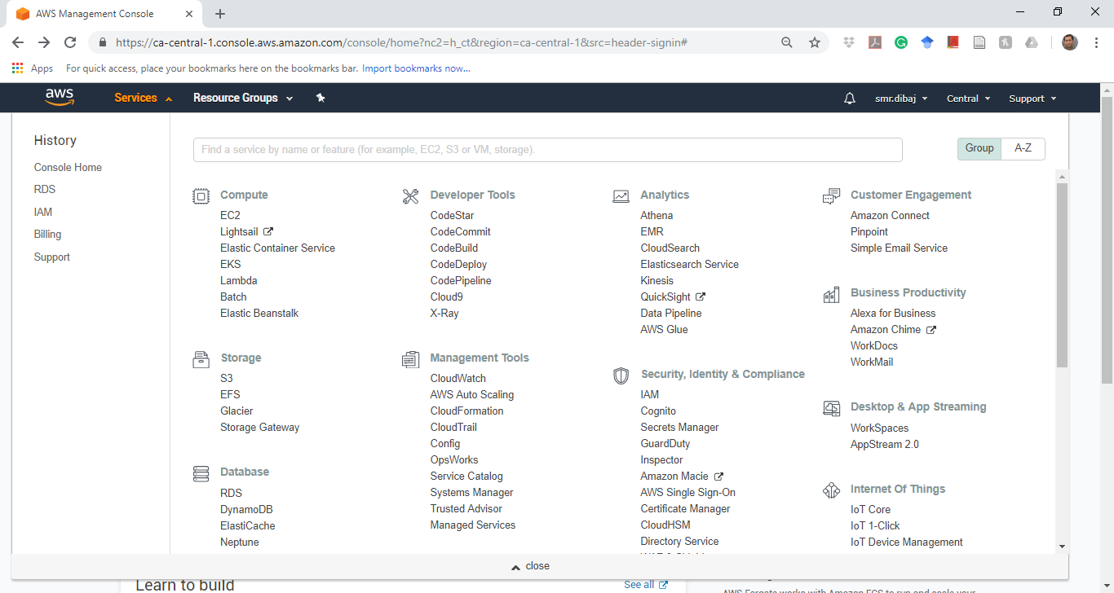
Create MySQL DB Instance

Slide 7
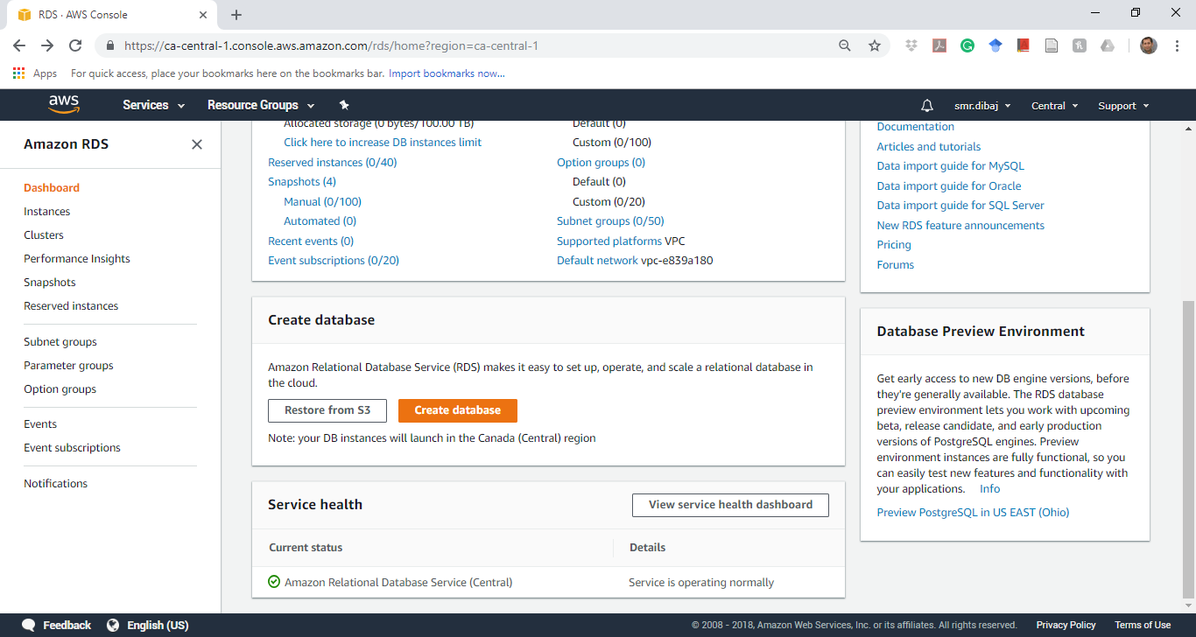
Create MySQL DB Instance

Slide 8
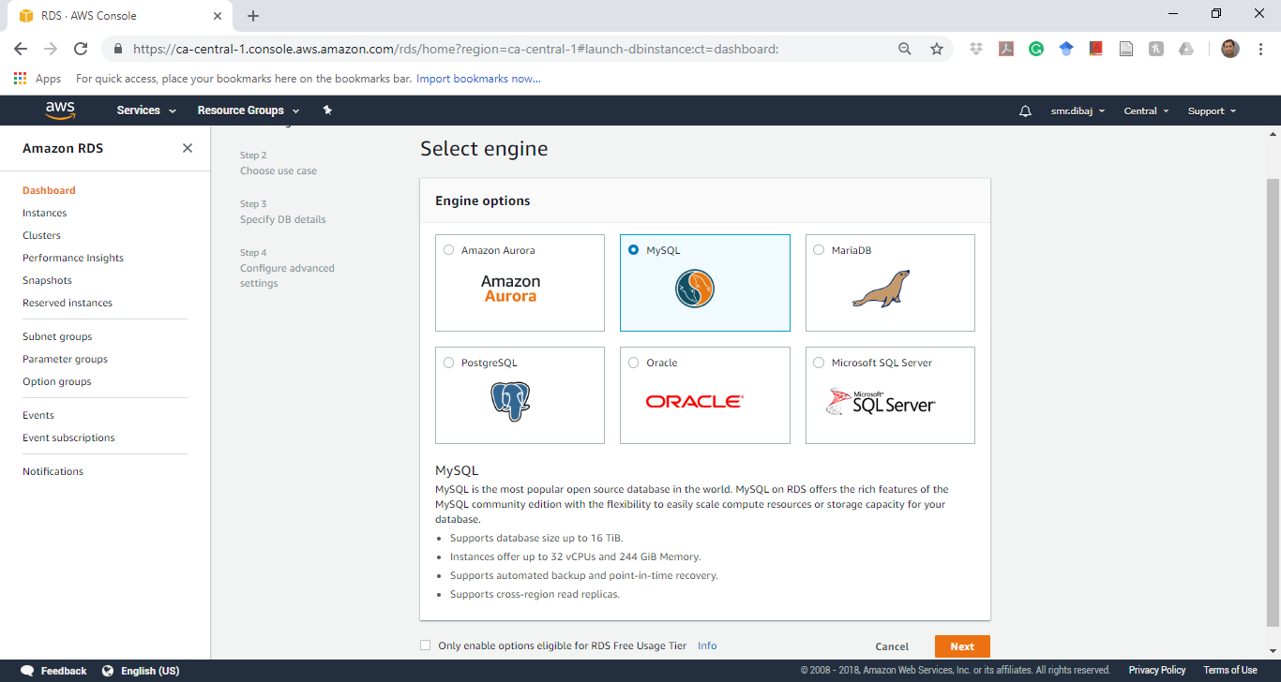
Create MySQL DB Instance

Slide 9
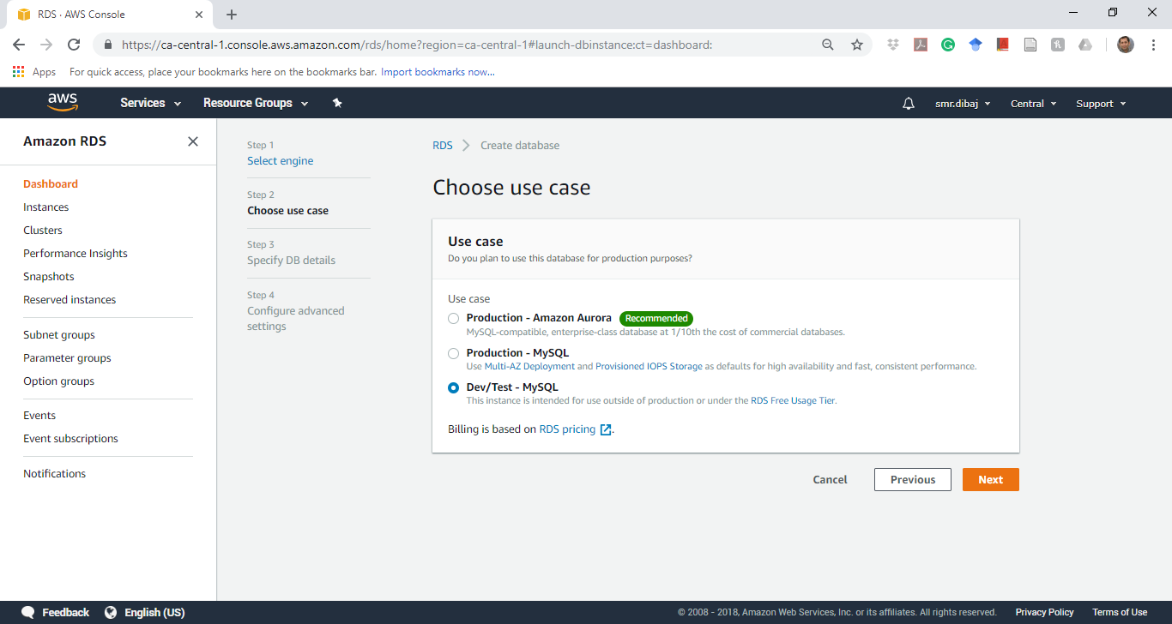
Create MySQL DB Instance

Slide 10
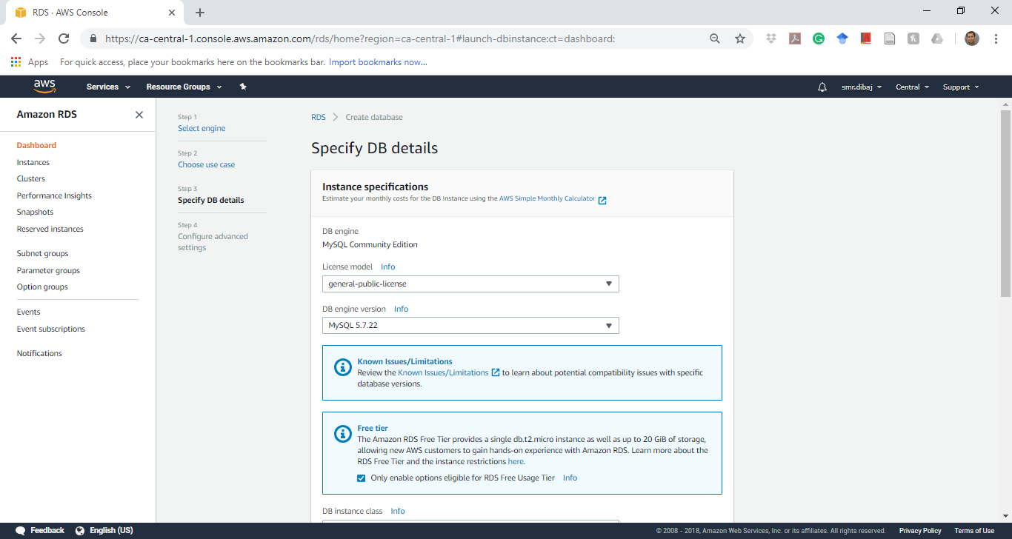
Create MySQL DB Instance

Slide 11
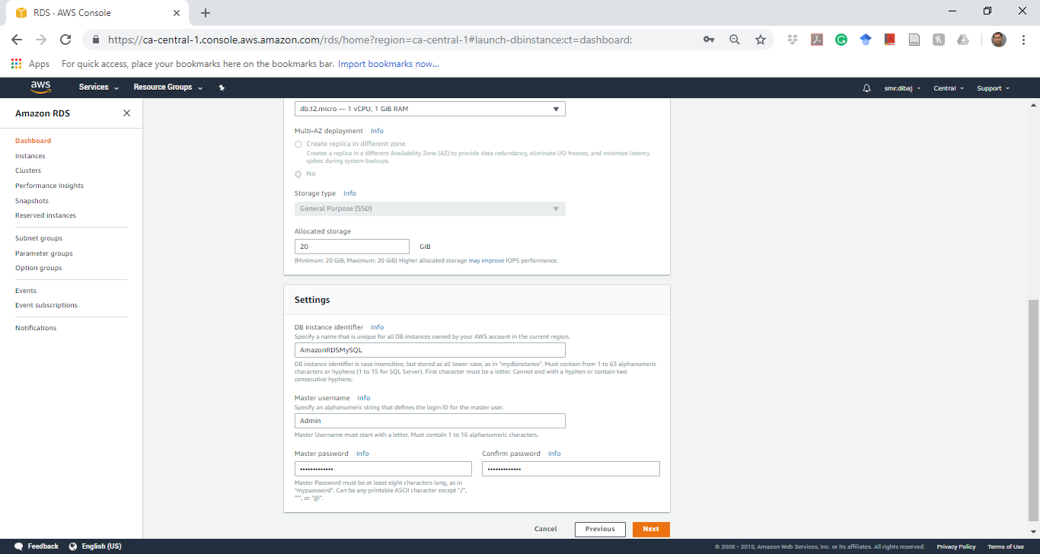
Create MySQL DB Instance

Slide 12
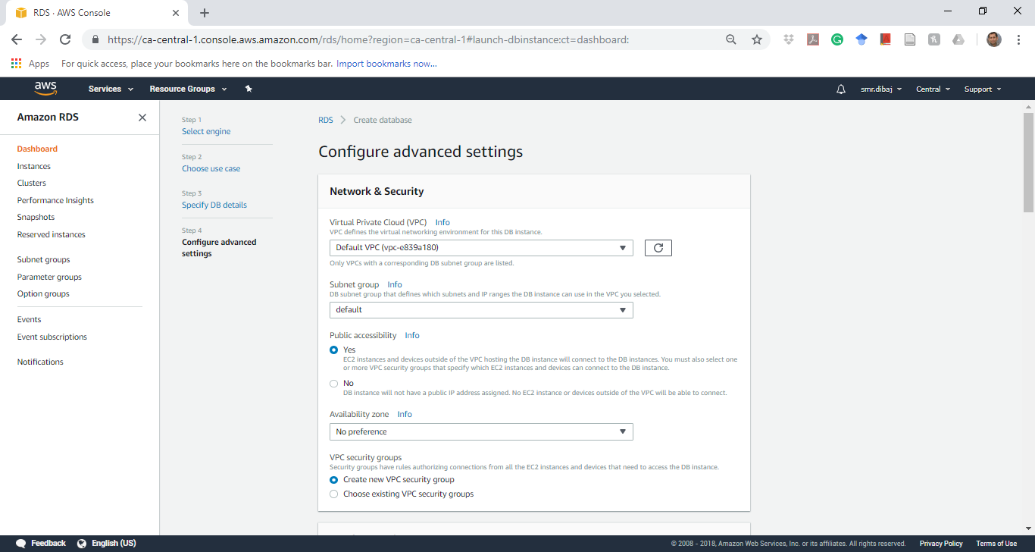
Create MySQL DB Instance

Slide 13
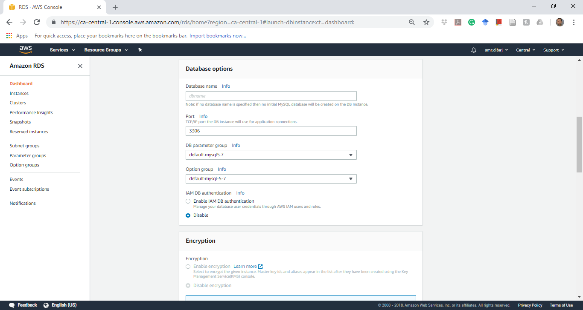
Create MySQL DB Instance

Slide 14
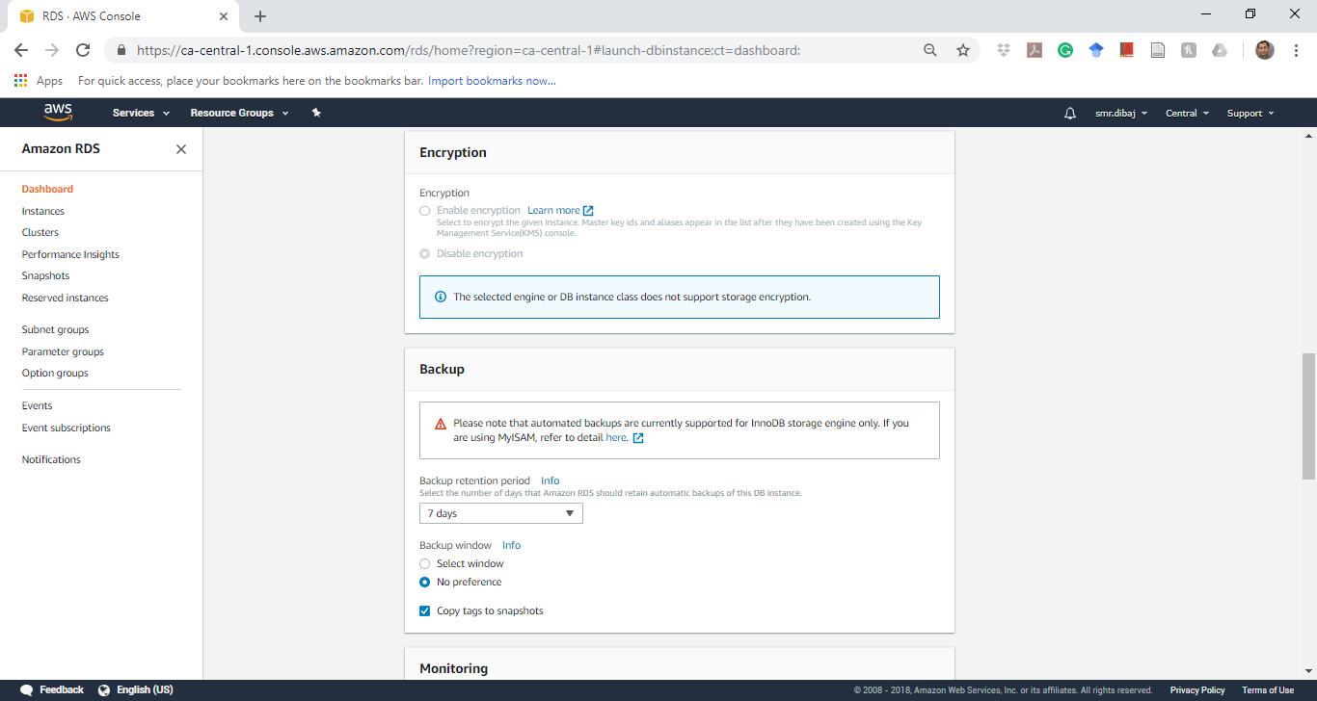
Create MySQL DB Instance

Slide 15
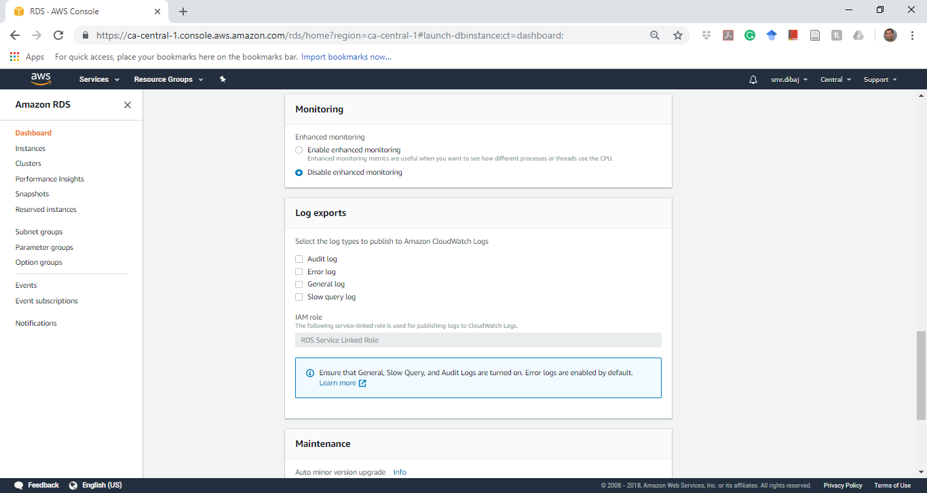
Create MySQL DB Instance

Slide 16
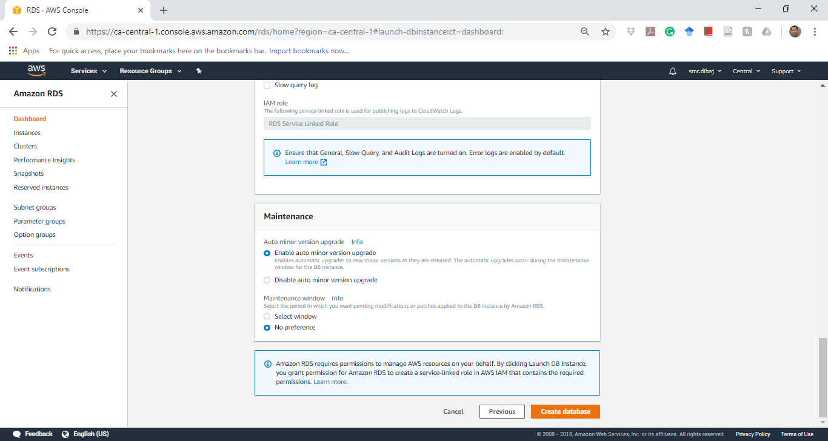
Create MySQL DB Instance

Slide 17
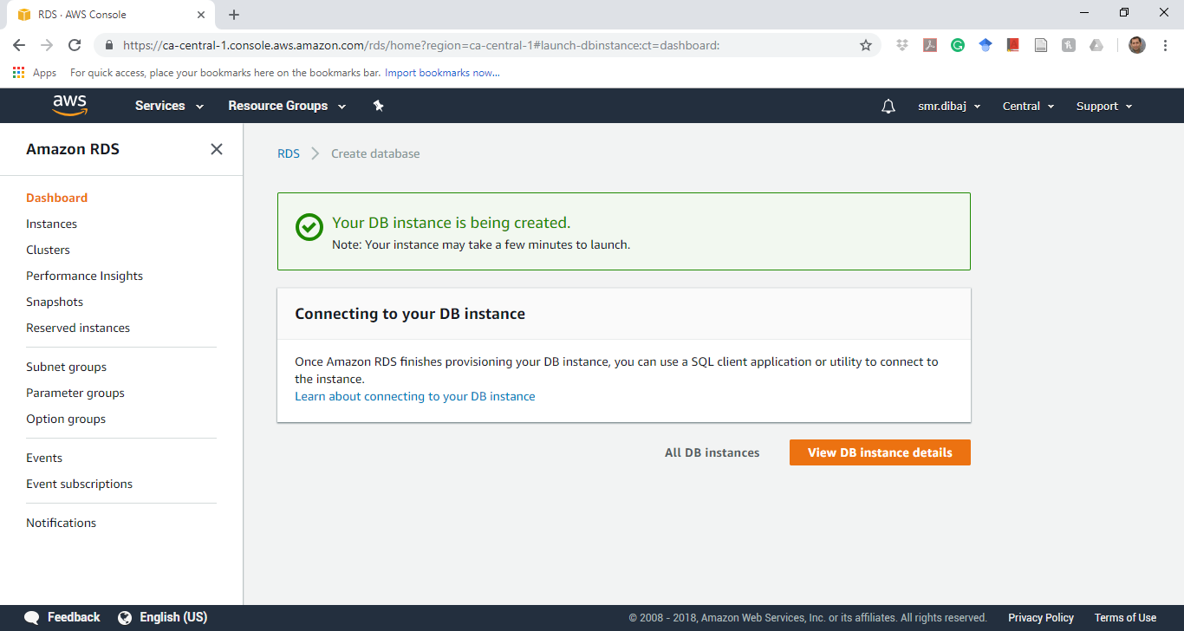
Create MySQL DB Instance

Slide 18
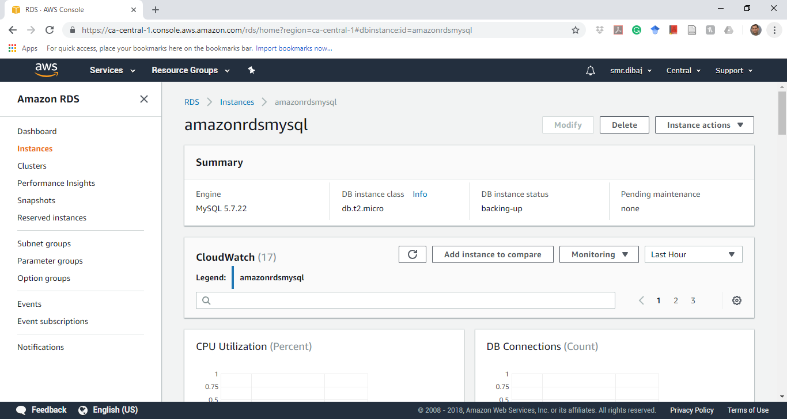
Create MySQL DB Instance

Slide 19
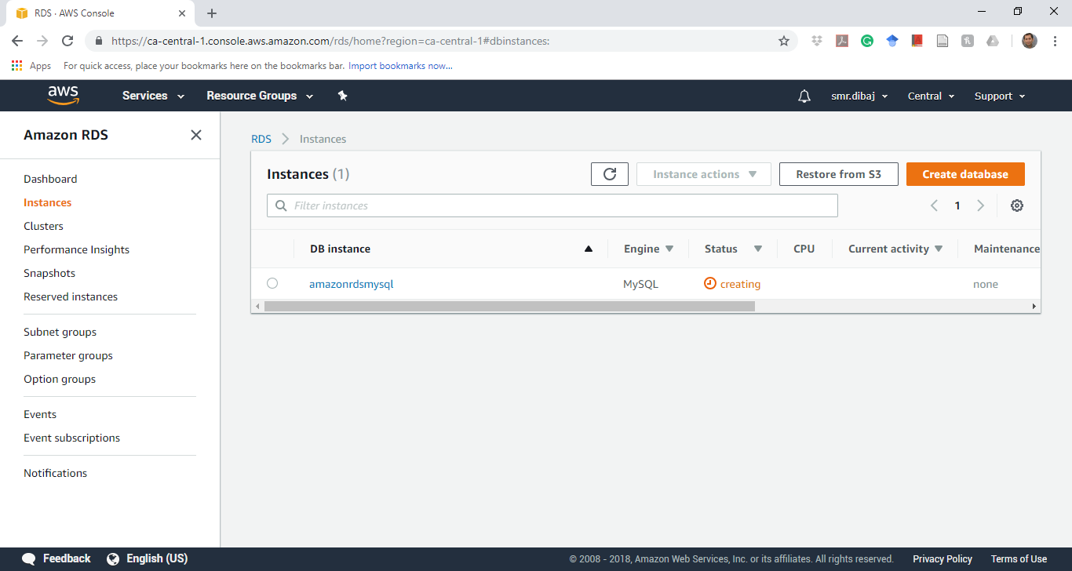
Create MySQL DB Instance

Slide 20

Create MySQL DB Instance

Slide 21
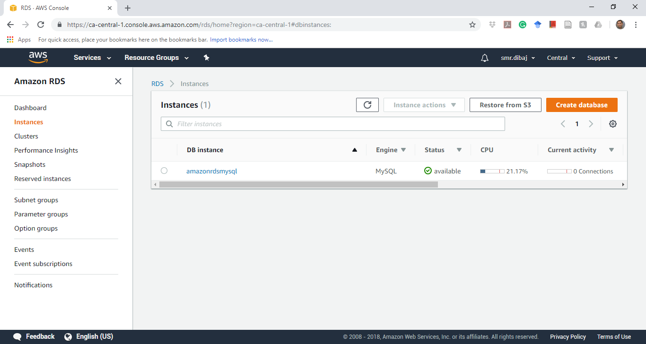
Create MySQL DB Instance

Slide 22
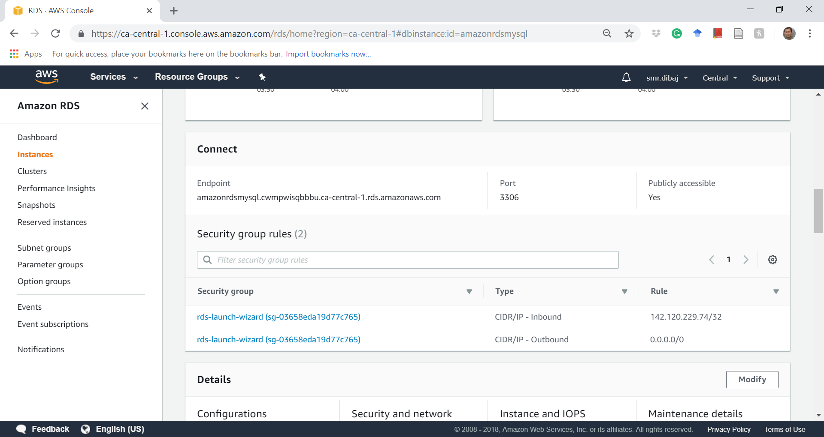
Create MySQL DB Instance
Notes:
amazonrdsmysql.cwmpwisqbbbu.ca-central-1.rds.amazonaws.com
3306

Slide 23
Connect to MySQL DB Instance
Connect to DB Instance Running the MySQL Database Engine
The MySQL Command Line Tool
MySQL Workbench
Download MySQL Workbench from here

Slide 24
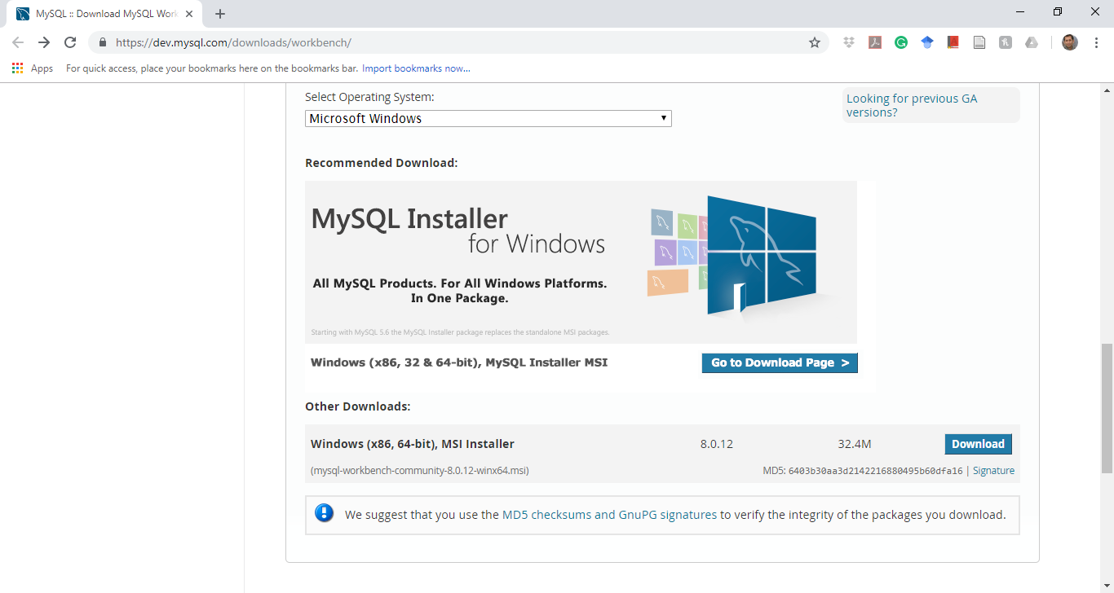
Connect to MySQL DB Instance

Slide 25
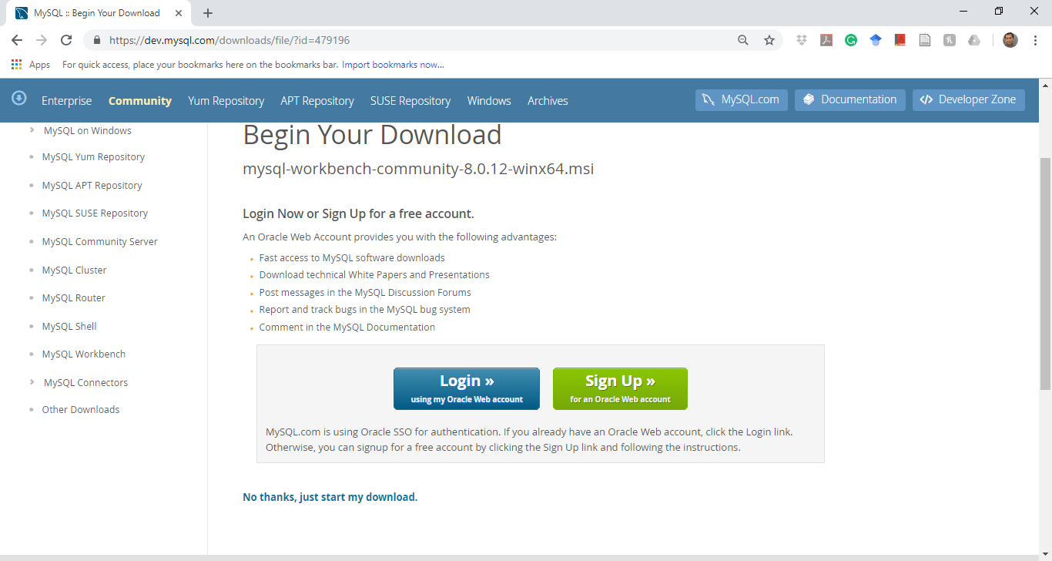
Connect to MySQL DB Instance

Slide 26
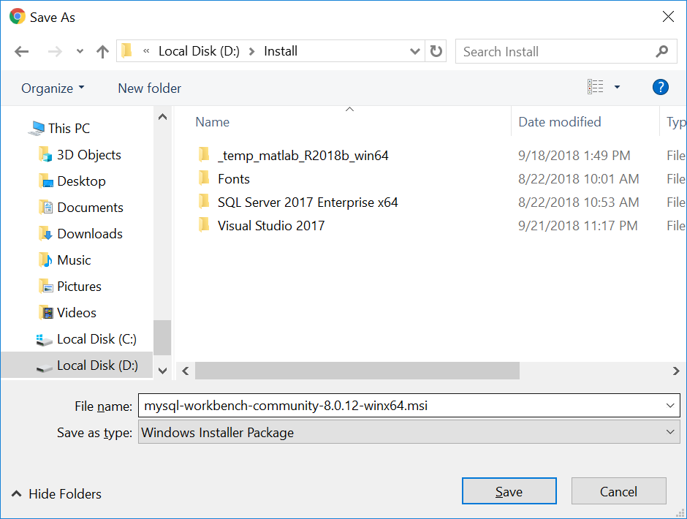
Connect to MySQL DB Instance

Slide 27
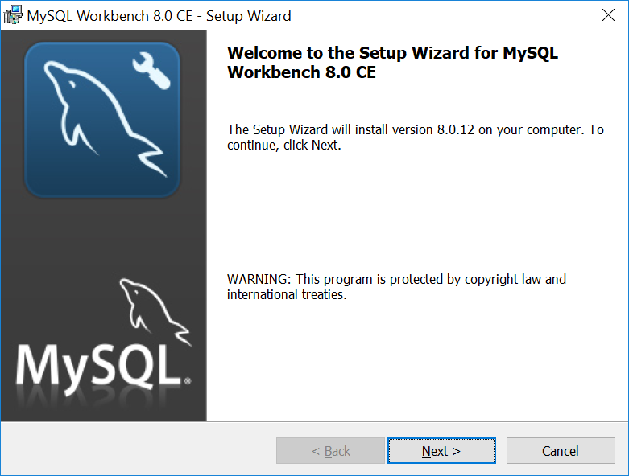
Connect to MySQL DB Instance

Slide 28
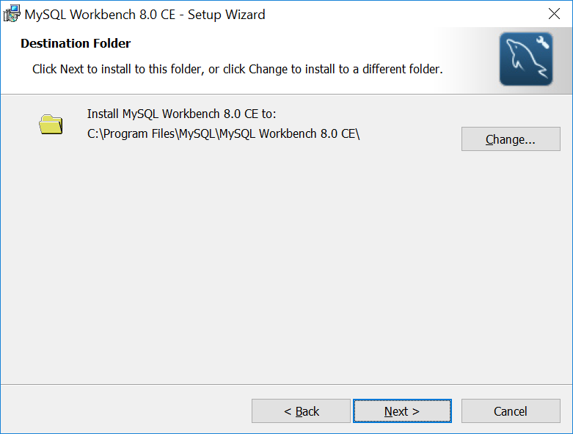
Connect to MySQL DB Instance

Slide 29
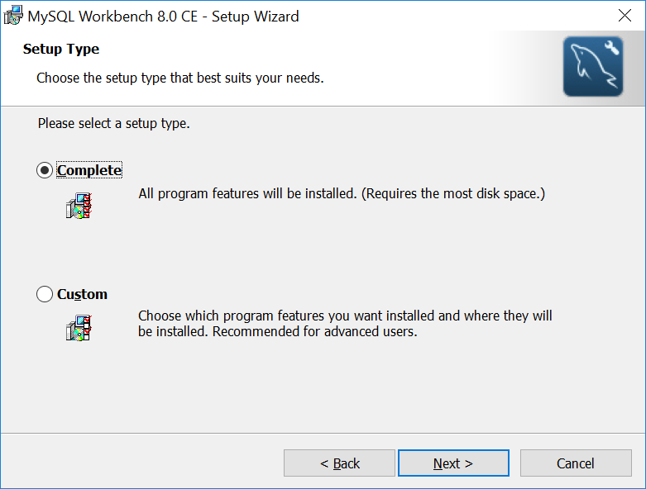
Connect to MySQL DB Instance

Slide 30
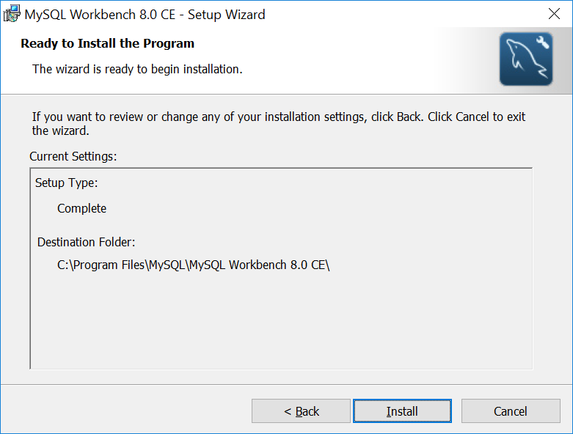
Connect to MySQL DB Instance

Slide 31
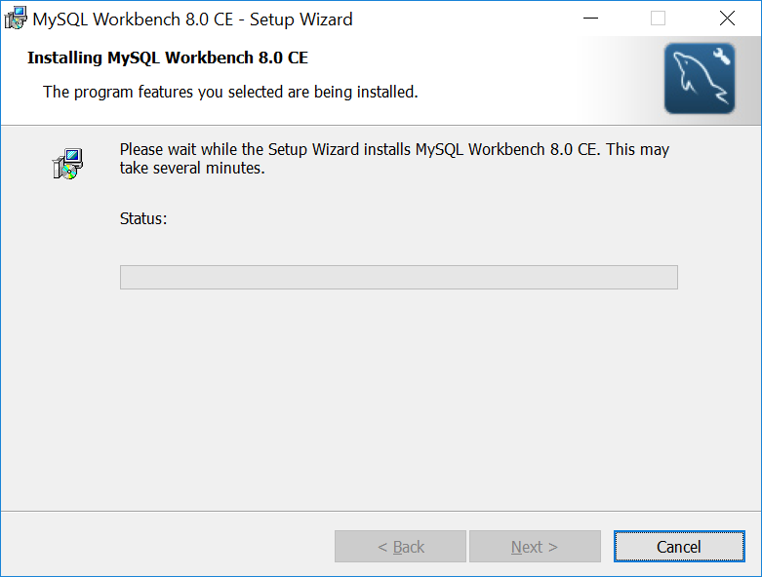
Connect to MySQL DB Instance

Slide 32
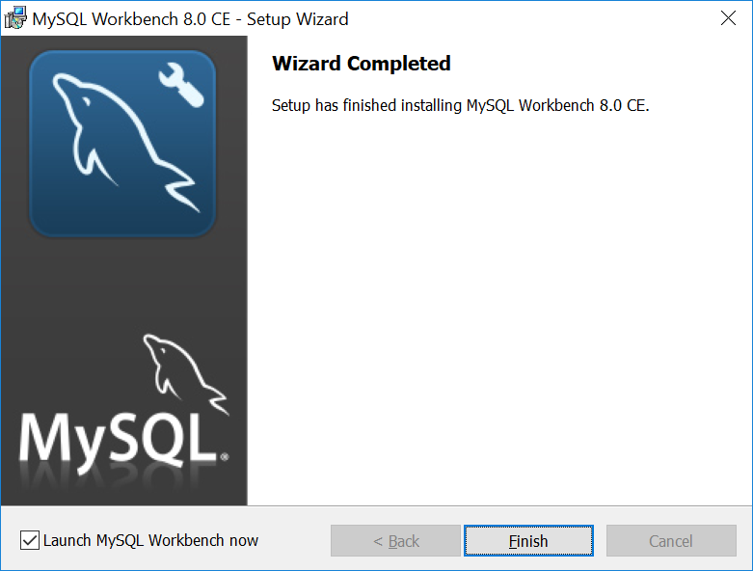
Create MySQL DB Instance

Slide 33
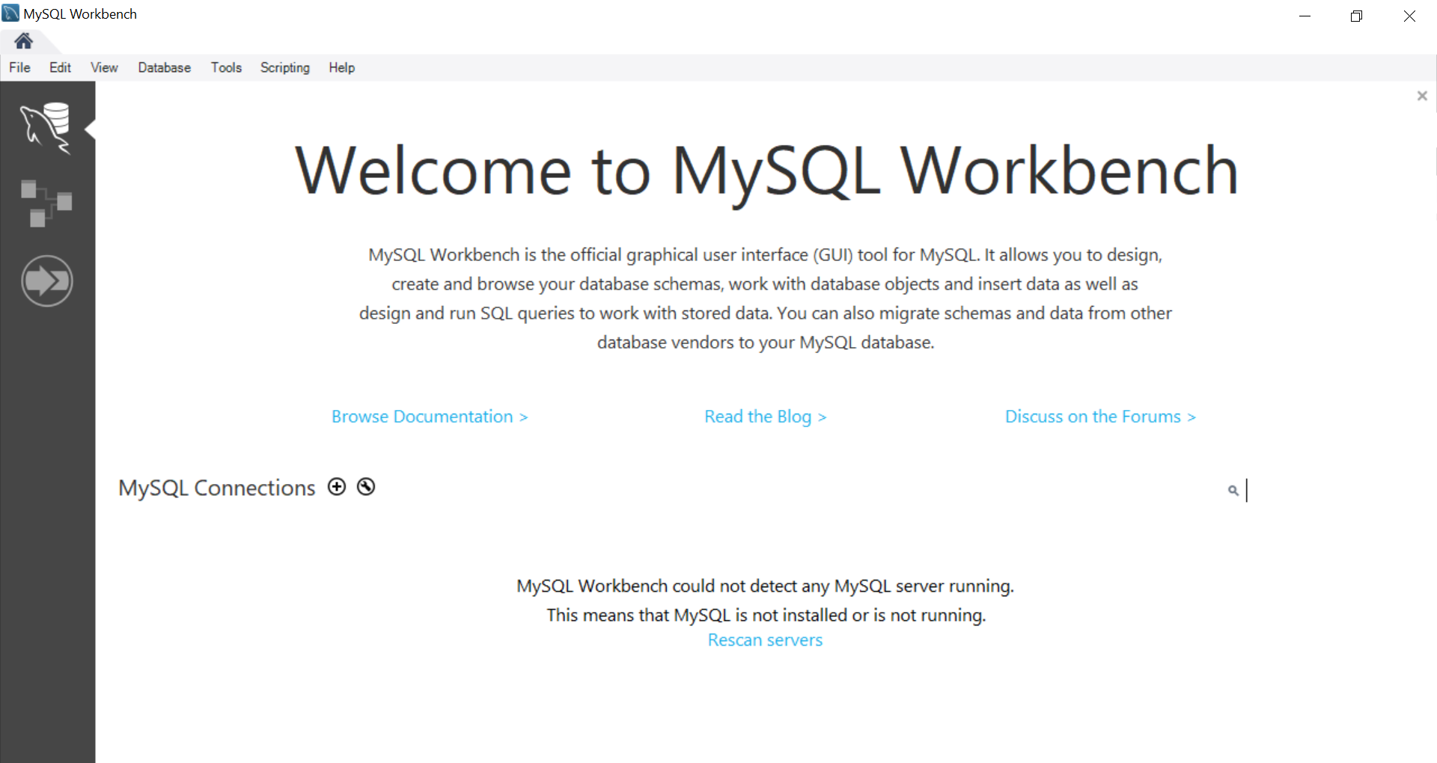
Connect to MySQL DB Instance

Slide 34
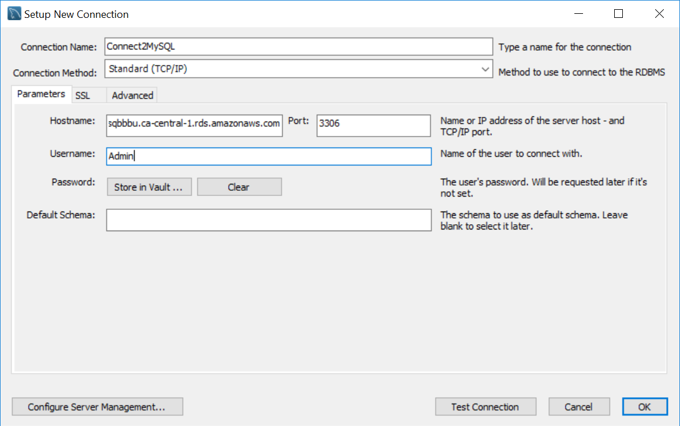
Connect to MySQL DB Instance

Slide 35
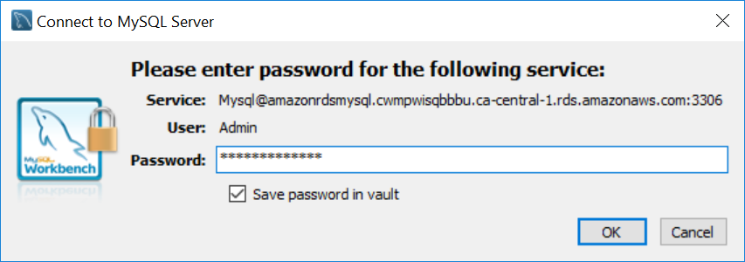
Connect to MySQL DB Instance

Slide 36
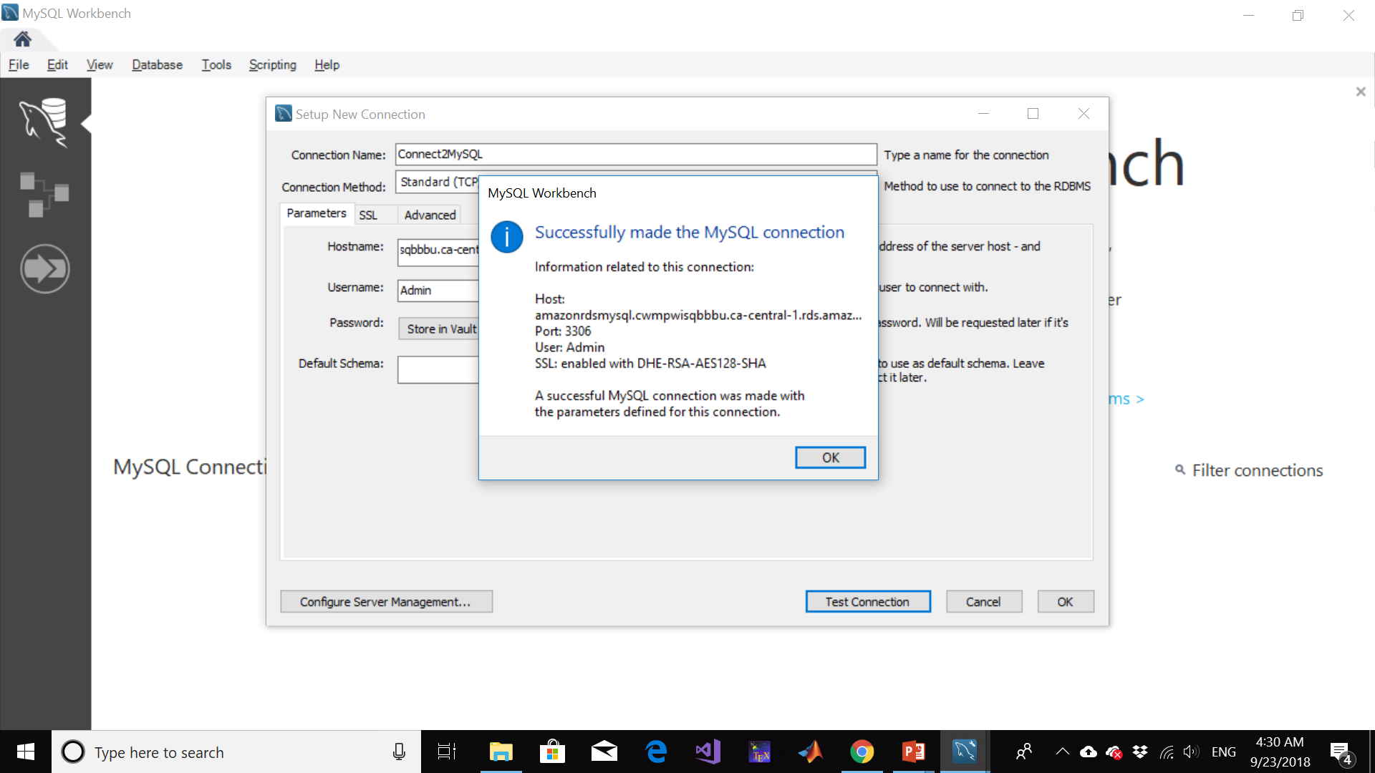
Connect to MySQL DB Instance

Slide 37
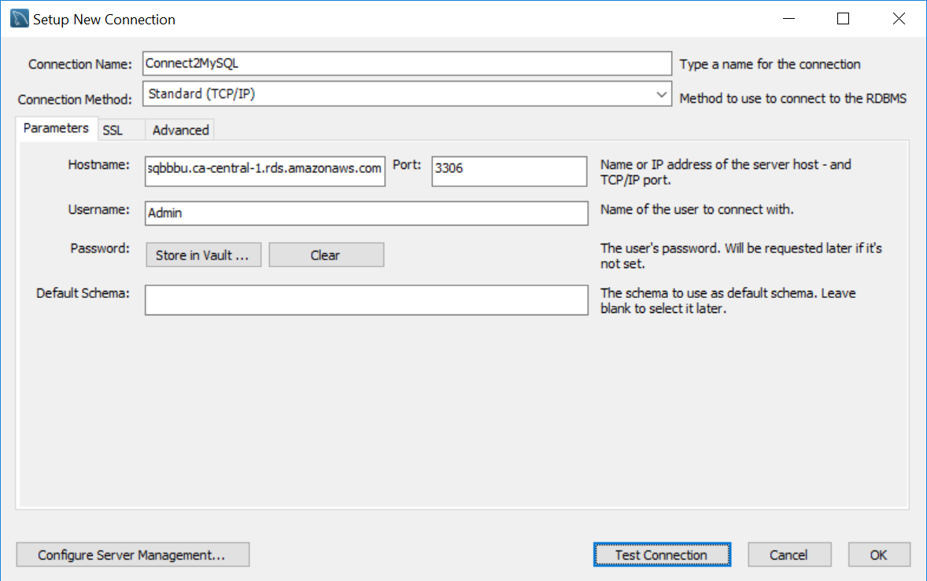
Connect to MySQL DB Instance

Slide 38
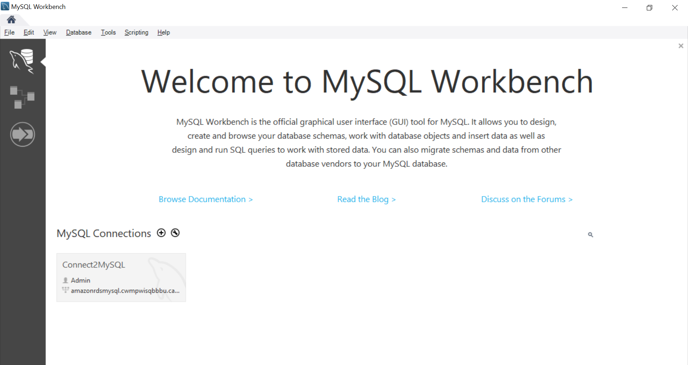
Connect to MySQL DB Instance

Slide 39
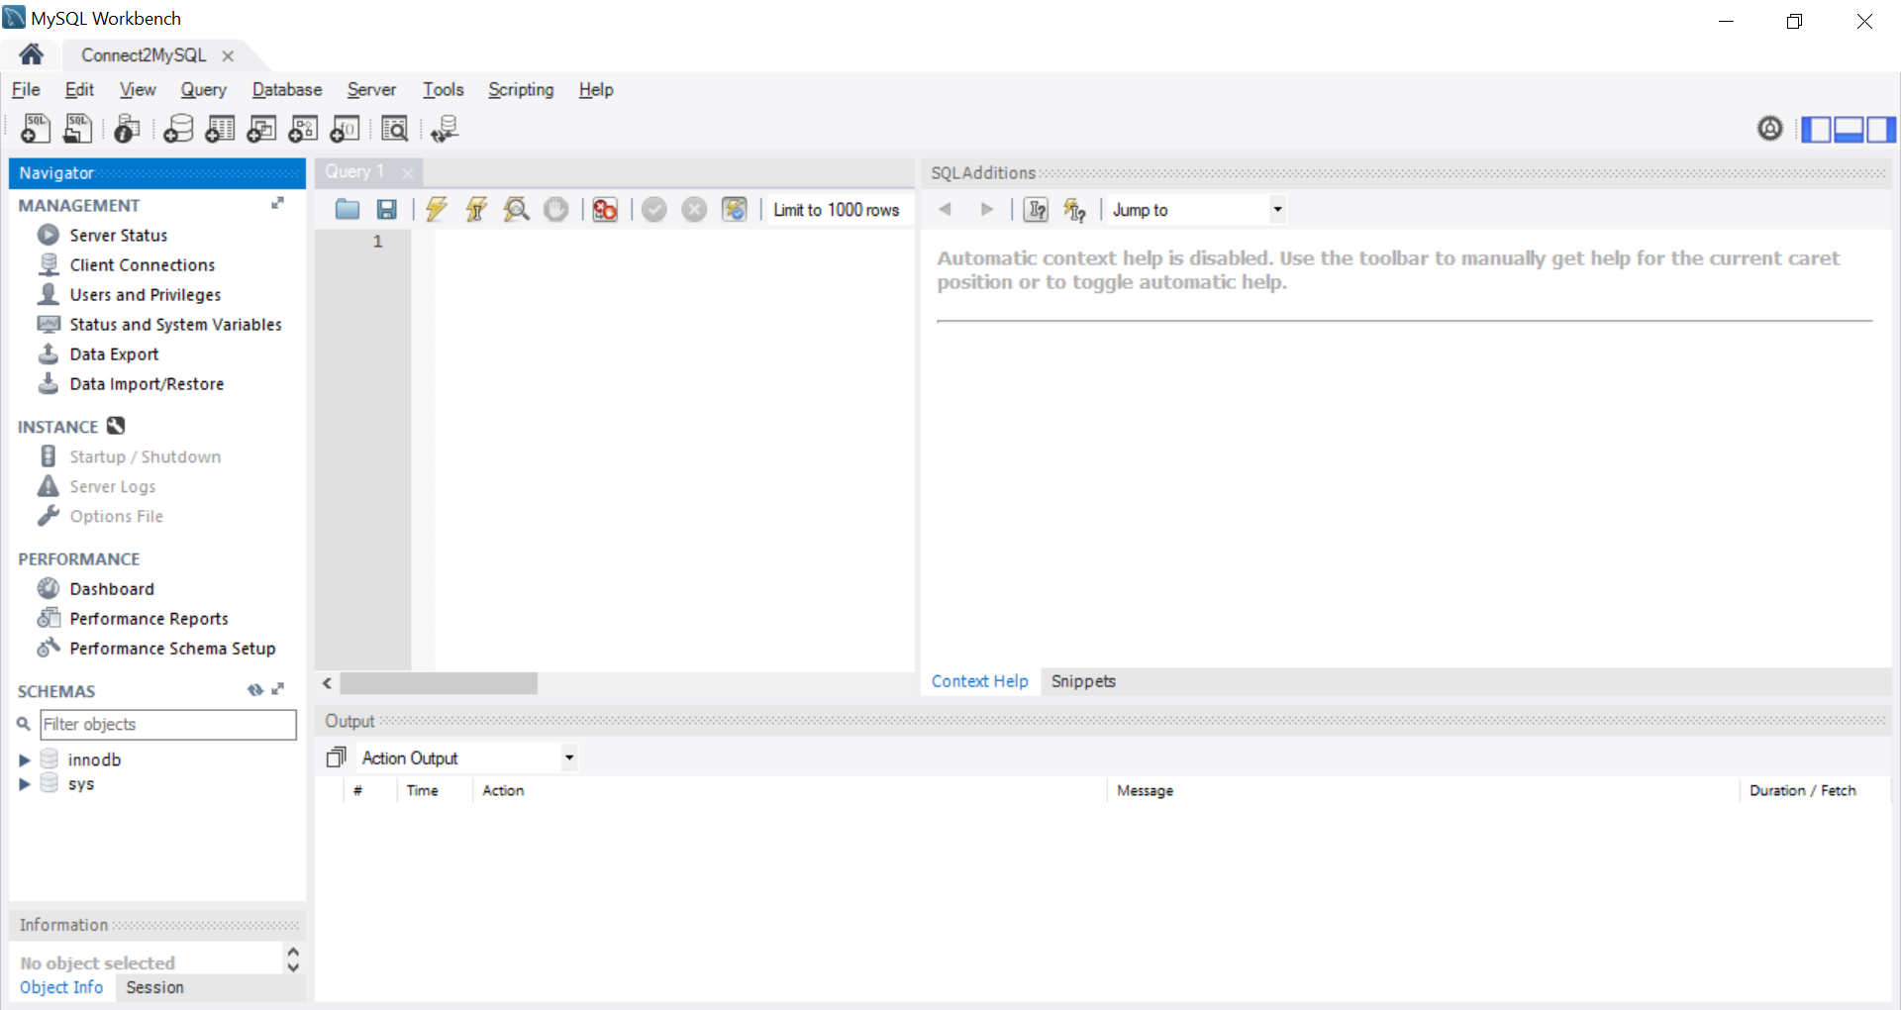
Connect to MySQL DB Instance

Slide 40
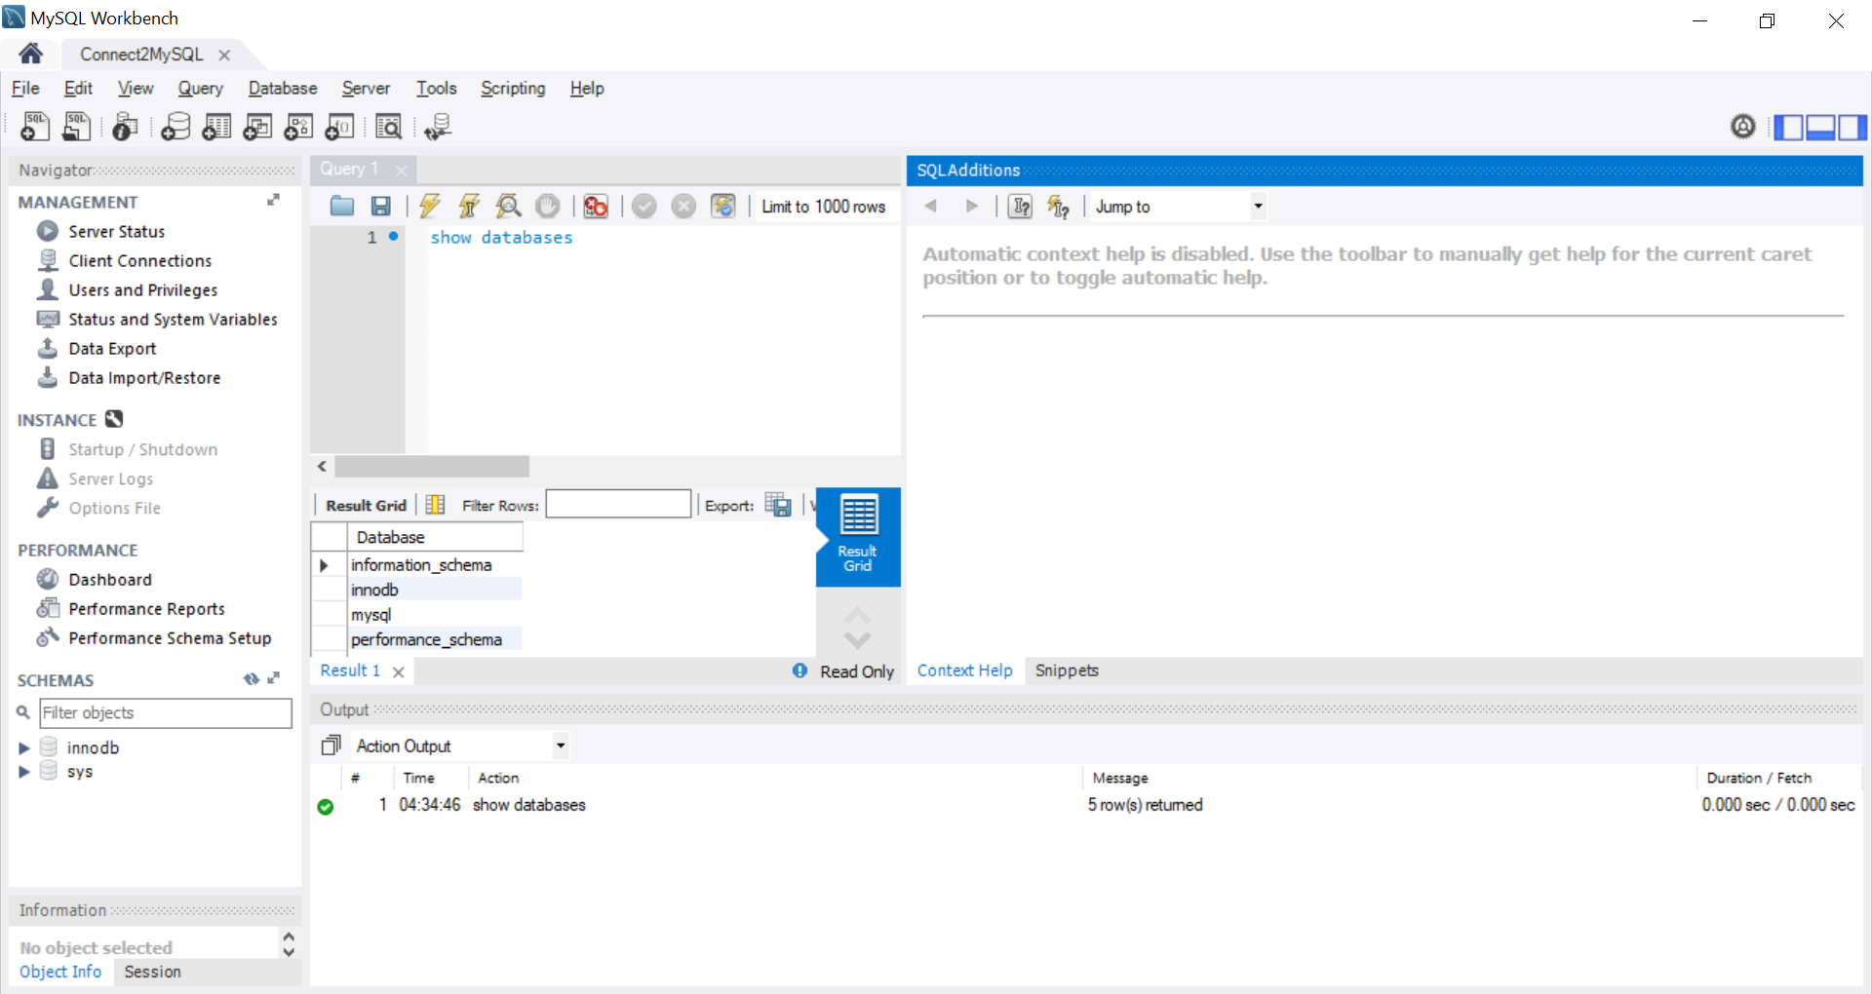
Connect to MySQL DB Instance

Slide 41
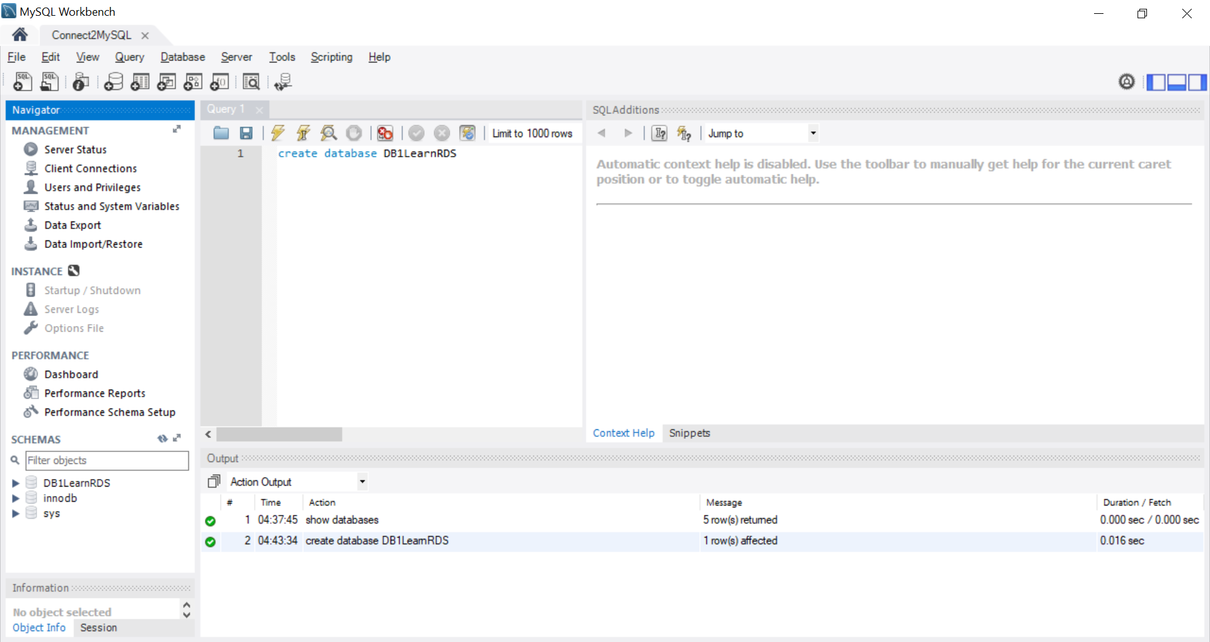
Connect to MySQL DB Instance
Notes:
Create database DB1LearnRDS;

Slide 42
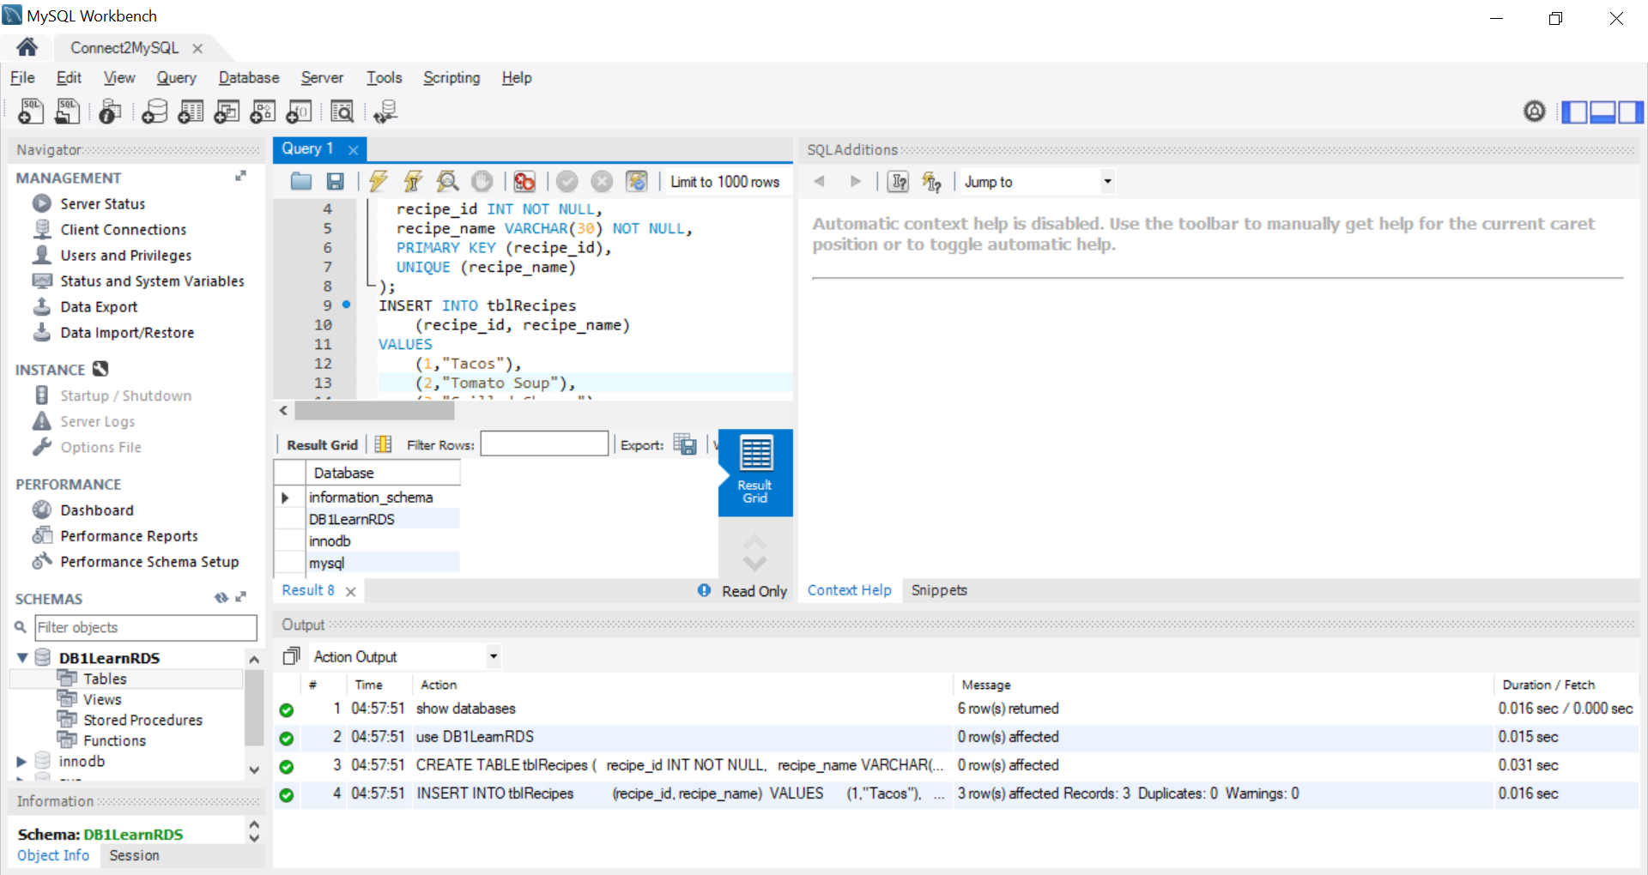
Connect to MySQL DB Instance
Notes:
show databases;
use DB1LearnRDS;CREATE TABLE tblRecipes ( recipe_id INT NOT NULL, recipe_name VARCHAR(30) NOT NULL, PRIMARY KEY (recipe_id), UNIQUE (recipe_name));
INSERT INTO tblRecipes (recipe_id, recipe_name) VALUES (1,"Tacos"), (2,"Tomato Soup"), (3,"Grilled Cheese");

Slide 43
Thank you

